Slide 1
Human Rights Issues in the Workplace

Slide 2
We will discuss…
What constitutes discrimination under the BC Human Rights Code?
Key features of the BC Human Rights Code.
What is equal pay for work of equal value?
What is employment equity?
What remedies are available under the BC HR Code?

Slide 3
And we will discuss…
Relevant HR laws in the hiring process and pre-employment testing
How HR legislation applies during the employment
How hard is “undue hardship”
The employer’s obligations when harassment happens

Slide 4
Historically…
Historically, discrimination was legal in Canada
Stores could refuse service
Landlords could refuse housing
Employers could refuse to hire individuals for whatever reason they chose, including race, gender, or marital status
British Columbia embraced racism vehemently.

Slide 6
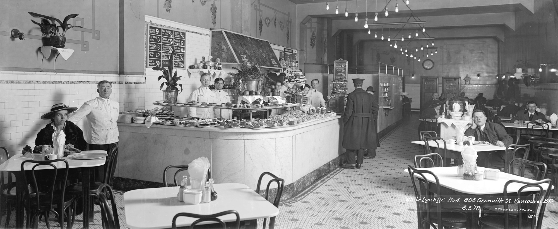

Slide 7
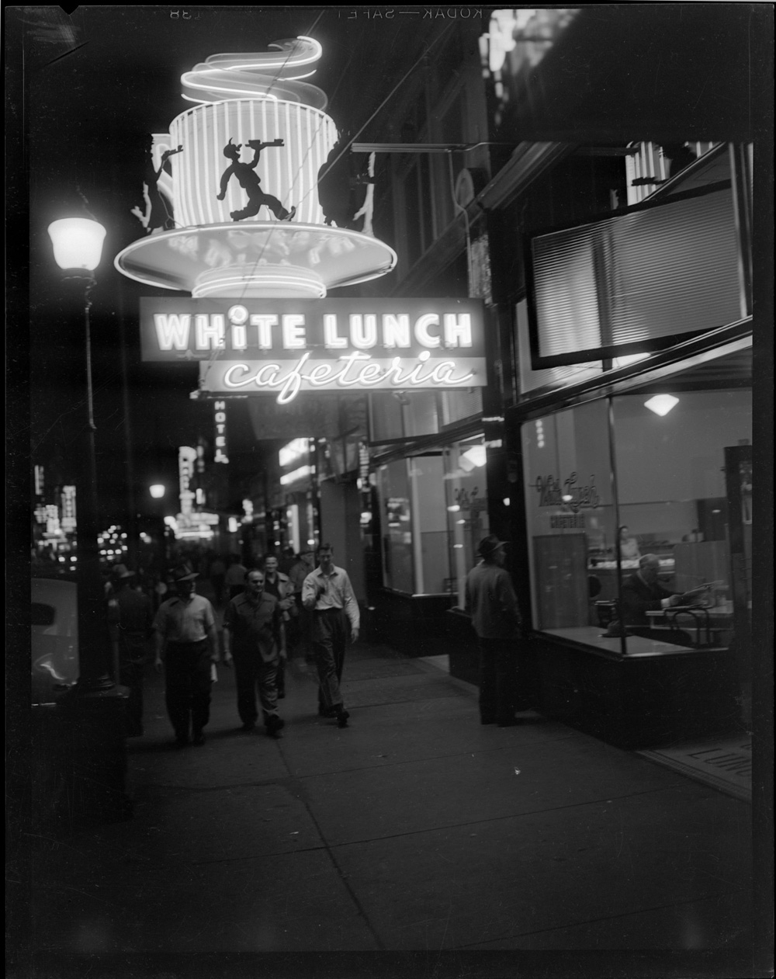

Slide 8
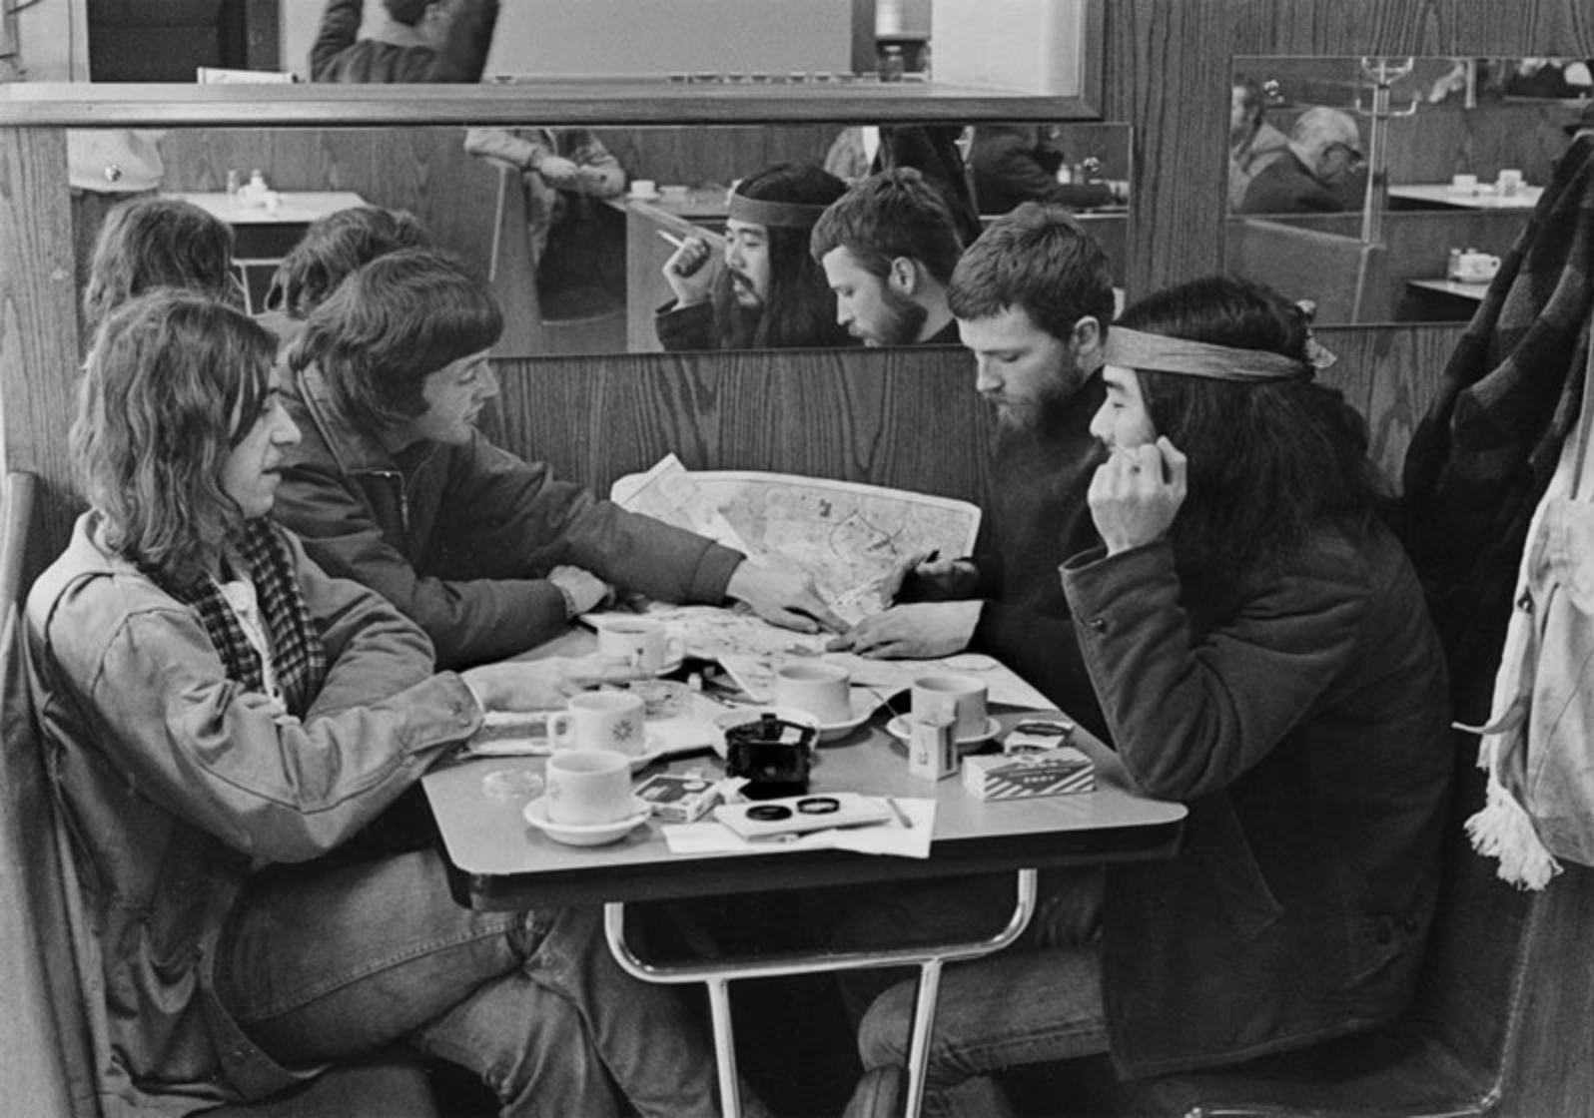

Slide 9
Human Rights Legislation
Now, every jurisdiction in Canada has human rights legislation that prohibits discrimination in key areas… including employment
Employers are required to maintain workplaces free from discrimination and harassment
Exists for the entire life of the employment relationship
Hiring—Training—Transfers—Promotions—Compensation
Performance evaluations—Discipline—Termination—Layoffs
BC Human Rights Code

Slide 10
Human Rights Legislation
Human rights legislation in British Columbia requires an employer to maintain a workplace that is free from discrimination and harassment
Employers must make all employment decisions, including those related to hiring, training, transfers, promotions, apprenticeships, compensation, benefits, performance evaluations, discipline, layoffs, and dismissals, on a non-discriminatory basis

Slide 11
Human Rights Legislation
The Canadian Charter of Rights and Freedoms (Charter), applies only to government actions
Provincial human rights statutes apply to the actions of individuals and corporations as well
And the scope of human rights law has been steadily expanding

Slide 12
Human Rights Legislation
BC introduced its first human rights legislation, the Human Rights Code in 1973
In BC the Code is primacy legislation: if there is a conflict between the Code and any other provincial legislation, the Code prevails (s 4)
Prohibits discrimination in employment on 15 grounds (if physical and mental disability are counted as separate grounds)
Amendments to the BC Code in 2016 added gender identity and expression to the list of protected grounds

Slide 13
What is Discrimination?
Discrimination is:
an act or omission;
intentional or unintentional;
that has the effect of creating a disadvantage or burden on a person or class of persons on grounds prohibited by law
Direct discrimination: an intentional act of exclusion
Indirect discrimination, also known as: “constructive discrimination” or “adverse impact discrimination”
Can arise due to systemic discrimination
It is the result of the workplace rule/policy that counts, not the intent
Focus of much HR law has shifted from direct to indirect discrimination

Slide 14
What is Discrimination?
Systemic discrimination (also called “institutional discrimination”) is a subtle form of indirect discrimination
The “web” of employer policies or practices that are neutral on their face but have discriminatory effects
Example: an informal mentoring through sports-related activities after working hours. Adversely effects employees with disabilities or family responsibilities. More difficult for them to build relationships, affecting performance evaluations and opportunities for promotion.

Slide 15
The Discrimination Test
Moore v British Columbia (Education), sets out the test to establish a prima facie case of discrimination
the complainant has a characteristic protected from discrimination;
the complainant experienced an adverse impact with respect to their employment; and
the protected characteristic was a factor in the adverse impact.
If the complainant proves each of these three elements, the burden of proof shifts to the employer, who must prove its policy, practice, or conduct is justified
If the employer fails to do so, the court finds discrimination and provides a remedy

Slide 16
Protected Areas:
Everyone has the right to be free from discrimination in these five main areas of activity:
Publications and notices
Goods or property, services, accommodation (housing and facilities)
Tenancies
Membership in trade unions and occupational associations
Employment practices including equal pay and advertisements
65% of complaints in BC and 85% of complaints in AB are about employment

Slide 17
Protected Grounds in BC:
Race
Religion
Colour
Sex
Sexual orientation
Physical disability
Mental disability
Age
Ancestry
Place of origin
Marital status
Family status
Political belief
Criminal or summary conviction unrelated to employment
Indigenous identity.

Slide 18
Basic Principles of BC Human Rights Code

Slide 19
About Religious Beliefs…
The Code protects people from discrimination on the basis of their religion or faith
It is prohibited for one person to attempt to force another to accept or comply with a particular religious belief or practice
The employer may also be required to take positive measures, such as allowing breaks for prayer at certain times
Religious beliefs and practices are protected, even if they are not essential elements of a particular religion, provided they are sincerely held
(The Alberta Act also specifically recognizes that religious beliefs include “native spirituality.”)

Slide 20
About Gender…
Code was amended to add gender identity and gender expression in 2016.
Tribunal defines gender expression as how a person presents their gender
Can include: behaviour and appearance, dress, hair, make-up, body language, voice, name and pronoun (such as he, she or they)
How a person presents their gender may not necessarily reflect their gender identity
Gender identity is a person’s sense of themselves as male, female or both, in between or neither
It includes people who identify as transgender
Gender identity may be different or the same as the sex a person is assigned at birth

Slide 21
Hiring Process…
Morrison was a male registered care aide who applied to work in a residential care home on two occasions. AdvoCare refused to hire him. The company continued to advertise for aides with the same qualifications as Morrison. A review of hires that occurred during the same period showed that a number of new graduates were hired without related experience.
Morrison was as qualified as (or more qualified than) the successful applicants.
No males were hired during that period.
Tribunal found that Morrison was not hired because of the employer’s stereotypical sex-related assumptions that he was aggressive and therefore not suitable for the job.
Tribunal found employer exaggerated minor performance concerns and inconsistencies in its hiring documentation, including a “red flag” guide that tells interviewers: “trust your gut!”
Although the employer did not intend to discriminate, intention need not exist for discrimination to occur.
Morrison was awarded $3,150 in lost wages, $3,773 for gas and lodging, and $5,000 for injury to dignity, feelings, and self-respect.

Slide 22
Discrimination in Hiring
The Tribunal applied the following test in Morrison for establishing a prima facie case of discrimination in the hiring stage:
In an employment complaint, the complainant usually establishes a prima facie case by proving:
1. that the complainant was qualified for the particular employment;
2. that the complainant was not hired; and
3. that either:
a. someone no better qualified but lacking the distinguishing feature which is the gravamen of the human rights complaint (sex, religion, race, etc.) subsequently obtained the position, or
b. the employer continued to seek applicants with the complainant’s qualifications.

Slide 23
Equal Pay for Equal Work
What is required in BC?
Employees of any sex must be paid the same rate for work that is the same or substantially similar
May not reduce the pay of the higher-paid employee to ensure equal pay for equal work
What is not required in BC?
Pay Equity (this requires employers to compare totally different jobs to determine whether or not they are equal in value)
Currently required only in Ontario and Quebec for federal employees
Employment Equity (requires employers to address the underrepresentation of certain groups of people (usually visible minorities - through planned hiring)
Currently required in the federal sector

Slide 24
But…
Section 13(4) of the BC Code indicates that an employer may make an employment decision that is discriminatory, provided that the decision is based on a bona fide occupational requirement (“BFOR”)
Discriminatory behaviour is not prohibited when an alleged contravention of the Act is “reasonable and justifiable in the circumstances”
For example, the Code does not require an employer to hire a blind school bus driver, because sight is a fundamental ability necessary to perform the job
The BC Code also allows certain organizations to grant “preference” to members belonging to “an identifiable group or class of persons.”
These identifiable groups or classes match the categories of persons discussed above with three exceptions—family status, sexual orientation, and conviction for an offence are not included
The exemption is granted where the organization has “as a primary purpose the promotion of the interests and welfare” of that identifiable group or class of persons and is “not operated for profit” (s 41)
An example: an agency that provides relief counselling to sexually abused women and hires only female staff

Slide 25
Affirmative Action…
Section 42 of the BC Code permits discrimination in the case of persons disadvantaged because of race, colour, ancestry, place of origin, physical or mental disability, or sex
Under this exemption, an employer may implement a special program to relieve or promote people who typically suffer from employment discrimination on the basis of those prohibited grounds
The Code identifies this special program as an employment equity program
For example, where the employer has a bona fide affirmative action program to hire someone from a First Nations background, the employer may discriminate in favour of people who fall within that category
This provision is consistent with sections 6(4) and 15(2) of the Charter

Slide 26
Unprotected Discrimination
To be protected, discriminatory treatment must be based on one of the prohibited grounds
Someone who is discriminated against on the basis of a ground not covered, such as social status or physical appearance, for example, does not infringe the Code

Slide 27
Making a Complaint
File within the time limit (1 year since incident)
Application is reviewed for completeness, jurisdiction, and initial merit
Respondents sent a copy of the complaint and given a time limit to respond to the allegations
If no response, complaint proceeds to review and orders may be made against the respondent
Settlement/mediation attempts
Case is heard by a human rights tribunal

Slide 28
Remedies
Cease the discriminatory policy or behaviour
Refrain from engaging in the same acts in the future
Award the complainant opportunities or privileges that were lost as a result of the discrimination
Compensate the complainant for lost wages, income, or expenses
Any other action the tribunal considers proper to put the complainant in the position they would have been in but for the discrimination
Public statement
Costs of proceeding

Slide 29
The Hearing
Hearings can proceed without the attendance of an affected party if notice was given and the party failed to show up
The complainant bears the initial burden of proof—that is, they must be able to show that discrimination occurred
After that, the respondent has the burden of showing on a balance of probabilities that the discrimination was a BFOR or that its duty to accommodate would have caused undue hardship
No automatic right to appeal the panel’s decision. A party must have valid grounds to have the decision reviewed by the BC Supreme Court

Slide 30
Issues in Recruitment, Selection, & Hiring

Slide 31
The Hiring Process
The hiring selection process is probably responsible for more discrimination than any other area of employment practice
At the hiring stage, assumptions, often subconscious, about certain groups of people and their abilities can come into play. Unspoken assumptions and first impressions lend themselves to subtle forms of discrimination
Tribunals have found a “subtle scent of discrimination” that permeates certain workplaces and amounts to a violation of human rights (Morrison v Advo-Care [2009] and the federal case of Turner v Canada Border Services Agency)

Slide 32
Hiring Best Practices (cont’d)
To protect themselves, employers should document all decisions made at each step of the hiring process and include the reasons for each decision
Clear and careful documentation, prepared at the time a decision is made, provides an employer with a credible basis to defend against allegations that the decision was made on discriminatory grounds
The Act is infringed even if a discriminatory ground is only one of several reasons for an employment decision

Slide 33
Essential Requirements of the Job
An employer who is recruiting should ensure a job description is:
Current;
Accurately reflects the employer’s needs and expectations; and
Identifies the essential requirements of the job.
If an essential requirement of the job negatively affects a person on a prohibited ground, the employer must accommodate to the point of “undue hardship” (for the employer)
Remember the BFOR above?

Slide 34
Essential Requirements of the Job
To be regarded as a BFOR (a standard that is necessary in spite of being discriminatory), the workplace policy, practice, or requirement must:
be adopted for a purpose rationally connected to the job;
be adopted in an honest belief that it was necessary to satisfy a legitimate business purpose; and
be reasonably necessary to accomplish that purpose—and it must be impossible to accommodate the individual without creating undue hardship.
Ex: Requiring a drivers’ license for Uber

Slide 35
Essential Requirements of the Job
The employer should review the job carefully to determine which requirements are essential for the job
Only essential duties should be considered in deciding whether or not some-one is capable of performing a job
Job duties or requirements that are both essential and relate to a prohibited ground of discrimination should be scrutinized carefully
For example, requiring a driver’s licence for a job that does not entail a lot of driving would unnecessarily bar a candidate who is unable to obtain a driver’s licence because of physical disability, and therefore could infringe the Act

Slide 36
Essential Requirements of the Job
On the other hand, if the job involves a lot of communication with the public, it is reasonable to require fluency in English
But it is unacceptable to discriminate against someone who speaks English with a non-Canadian accent.
Although language is not a prohibited ground of discrimination, it relates to place of origin
Where an essential job requirement negatively affects a person or group based on a prohibited ground of discrimination, an employer has a duty to accommodate the individual or group unless this causes undue hardship

Slide 37
BFOR
In 1999 the Supreme Court of Canada issued the Meiorin decision
Meiorin was a firefighter who lost her job when her employer implemented a new physical fitness test as a bona fide occupational qualification.
Ms. Meiorin was a forest firefighter who had performed her job in a satisfactory manner for three years when her employer, the BC government, implemented a new policy under which all firefighters were required to pass a series of fitness tests.
A team of researchers at the University of Victoria had designed the tests using a sample group of participants that consisted of many more men than women.

Slide 38
BFOR
To measure aerobic capacity, the test required employees to run 2.5 kilometres in 11 minutes or less.
Meiorin tried to pass this part of the test on four separate occasions, but her best time was 49 seconds over the 11-minute limit.
As a result, the government terminated her employment as a forest firefighter.
The Supreme Court of Canada found that the rule was discriminatory because Meiorin was able to show the aerobic requirement screened out more women than men on the basis of their differing physical capacities.
The issue was whether the discriminatory rule or standard could be justified.

Slide 39
BFOR
Reversing previous law, the Court ruled that there should not be separate categories of discrimination: direct and constructive (adverse impact).
Whatever form discrimination takes, job rules or qualifications that detrimentally affect people or groups on the basis of a prohibited ground of discrimination should be subject to the same analysis.
The Court established a three-part test to determine when a discriminatory rule or qualification is justifiable.
To successfully defend a discriminatory standard or rule, the employer must:
1. demonstrate that a rational connection exists between the purpose for which the standard was introduced and the objective requirements of the job;

Slide 40
BFOR
2. demonstrate that the standard was adopted in an honest and good-faith belief that it was necessary for the per-formance of the job; and
3. establish that the standard was reasonably necessary to accomplish that legitimate work-related purpose.
To establish this, the employer must show that it was impossible to accommodate employees who share the characteristics of the claimant without imposing undue hardship on itself.
The employer in Meiorin met the first two tests but failed the third.
BC government was unable to prove that the aerobic standard was reasonably necessary for a forest firefighter to perform the job safely and efficiently or that accommodation was impossible… without undue hardship.

Slide 41
Undue Hardship
Once an employee makes a prima facie case of discrimination, the onus shifts to the employer to present evidence showing that accommodating the employee would create undue hardship
Undue hardship is not defined in the legislation
Instead, we draw inferences from case law regarding the factors that are normally considered when evaluating undue hardship
The Supreme Court emphasizes the importance of interpreting undue hardship reasonably and in consideration of each unique situation: “What constitutes [undue hardship] is a question of fact and will vary with the circumstances of the case” (at 984)

Slide 42
Undue Hardship
Tribunals have found that undue hardship occurs if accommodation creates “onerous conditions,” “intolerable financial costs,” or “serious disruption” to the business
Some hardship may be unavoidable, but where the line is drawn in each case depends on the following factors:
1. Financial costs. These must be quantifiable, not merely speculation
For example, if an employee has multiple sclerosis and deterioration is expected over time, the fact that additional accommodation may be needed in the future cannot be used to assess the employer’s current ability to accommodate
Costs must be so significant that they would substantially affect the productivity or efficiency of the employer
A tribunal would normally consider the costs to the entire organization, not just one branch or unit

Slide 43
Undue Hardship
Furthermore, a tribunal will take into consideration the ability to amortize costs (spread them out over time), as well as any tax exemptions, grants, or subsidies that will offset anticipated losses
2. Size and resources of the employer
The costs of modifying premises or equipment and the ability to amortize those costs will be considered
The larger the organization, the more likely it will be that it can afford a wider range of accommodations without reaching undue hardship
3. Disruption of operations
This refers to the extent to which an employer is prevented from carrying out essential business functions
For example, if no productive work is available to offer an employee, then accommodation may create an undue hardship

Slide 44
Undue Hardship
4. Morale problems of other employees
Morale problems refer to the effects of an increased workload for other employees
This might include excessive overtime, stress, sleep difficulties, or other health problems
It will not be undue hardship if co-workers are simply disgruntled and would prefer the employee was accommodated elsewhere
5. Substantial interference with the rights of other individuals or groups
This ensures that an accommodation itself does not result in discrimination
The concerns of other employees must be well-grounded
An example might include an accommodation that is a substantial departure from the terms and conditions of a collective agreement
For example, seniority rights of unionized employees are considered a cornerstone provision of a collective agreement and should not be interfered with lightly (see Kelowna City and CUPE Local 338 [2003])

Slide 45
Undue Hardship
6. Interchangeability of workforce and facilities
The ability to relocate employees to other positions on a permanent or temporary basis is a factor in evaluating undue hardship and makes it easier for larger organizations to accommodate
7. Health and safety concerns.
If an accommodation is potentially a safety risk, the employer must consider the level of risk and who bears the risk
If the potential harm is minor and unlikely to occur, or if the risk is primarily to the employee seeking accommodation, it is unlikely to be considered an undue hardship
The employer will be expected to consider ways of reducing the safety concern

Slide 46
Use of Employment Agencies
BC: Section 13(2) expressly prohibits discrimination by employment agencies
Specifically: refusing to refer a candidate, based on a prohibited ground
Agencies cannot accept requests, or act on requests, to hire people based on preferences related to prohibited grounds of discrimination

Slide 47
Job Advertisements
Where and how a job is advertised is important
Section 11 of the BC Code prohibits job ads that directly or indirectly discourage people from applying based on a prohibited ground
The wording of a job ad should focus on the qualifications and skills that are required for job performance only

Slide 48
Job Application Forms
The application form should:
Avoid discouraging candidates from applying; and
Avoid eliciting information that directly or indirectly excludes individuals on non job-related grounds

Slide 49
Conditional Offers of Employment
No contract of employment exists when a conditional offer is made by an employer until those conditions have been fulfilled by the candidate
The conditions may allow the employer to gather information from the candidate that, earlier in the recruitment process, would have been forbidden by the Code
Information that should be requested only after a conditional offer:
Copy of a driver’s license;
Work authorization from immigration;
Social insurance card;
Transcript or copy of professional credentials; and
Requests for medical or health information.

Slide 50
Pre-Employment Medical or Fitness Examinations
Any form of medical testing:
Must be left to the conditional offer stage;
Must be a bona fide occupational requirement (BFOR);
The employer must perform the same test on every candidate; and
The employer must maintain confidentiality of test results.

Slide 51
Pre-Employment Drug and Alcohol Testing
Drug or alcohol dependence is a disability
Testing in and of itself is not prohibited
However, the best advice is not to conduct these tests
Pre-employment screening does not measure on-the-job impairment or predict the candidate’s ability to do the job
If you test and it comes back positive, it triggers:
the responsibility to determine if it is due to a disability; and
the requirement to accommodate to the point of undue hardship.

Slide 52
Issues During Employment

Slide 53
Duty to Accommodate
The following are regarded as fundamental principles of accommodation in the context of human rights law:
Individualization: Recognizing that the needs of each person are unique
Dignity: This includes respecting privacy, comfort and autonomy
Inclusivity: Workplace policies can’t be planned solely upon the needs of ‘average’ or ‘normal’ employees
Accommodation is a shared and ongoing obligation:
Employer
Employee
Union

Slide 54
Fulfilling the Duty to Accommodate Disability
Gather medical information (with consent) to determine functional abilities
Consult with employee, supervisor, union
If possible, modify the employee’s current job requirements; if not, assess other available jobs
Assess undue hardship of proposed accommodations
Implement
Monitor frequently
Document all facets of the accommodation process—including:
Alternatives considered
Reasons the alternatives were not accepted
Maintain confidentiality throughout

Slide 55
Fulfilling the Duty to Accommodate - Substance Abuse
Substance abuse is a disability.
Purely recreational use of drugs or alcohol is not a disability
Accommodation usually means offering rehabilitation or time off to attend a program
An employer is not required to accept ongoing, lengthy absences unrelated to the rehabilitation.
Be consistent and persistent.
Use “Last Chance” agreements, if necessary.

Slide 56
Fulfilling the Duty to Accommodate - Age
Social and legal shift in attitude about age discrimination
Older workers may need to work for social or financial reasons
Older workers make valuable contributions
Previous cases justified age discrimination as justifiable for economic reasons and to ensure workforce “renewal”
2008 BC Code amended to prohibit mandatory retirement
Mandatory retirement does not meet Charter “minimal impairment” test

Slide 57
On-the-Job Drug and Alcohol Testing
Pre-employment testing is prohibited
On-the-job selective testing may be carried out:
Where there is reasonable suspicion of impairment
Where an employee is involved in a workplace accident or incident
As a part of an agreed rehabilitation or return-to-work plan
Universal random testing may be carried out:
If there is evidence of reasonable cause or necessity (rampant drug/alcohol use)
Where the workplace is extremely dangerous
Where test result is positive, tailor sanction to fit circumstances (no automatic termination)

Slide 58
Issues During the Course of Employment: Harassment
In BC harassment is prohibited if associated with a protected ground
The Act prohibits any public display likely to expose a person or class of persons to hatred or contempt
Examples of prohibited behaviours include:
Verbal or physical abuse
Threats, derogatory remarks, jokes, innuendo, or taunts about appearance or belief
The display of pornographic, racist, or offensive images
Practical jokes that result in awkwardness or embarrassment
Unwelcome invitations or requests (explicit or implied)
Intimidation, leering, or other objectionable gestures
Condescension or paternalism that undermines self-confidence
Unwanted physical contact including touching, patting, pinching, or punching

Slide 59
Types of Harassment
Poisoned work environment
Comments or actions are not directed at an individual, but have made the workplace hostile or unwelcoming to them
Sexual harassment
Comments or actions based on sex that are unwelcome, or should be reasonably known to be unwelcome
Normally requires a course of vexatious conduct rather than a single instance, unless very serious
“Sexting”
Sexual solicitation
Someone in a position of authority makes unwelcome advances or requests for sexual favours
The threat of reprisal or promise of reward is explicit

Slide 60
Harassment
Legal standard for determining if harassment has occurred:
Would a reasonable person think the conduct or comment was inappropriate?
There is an onus on the person experiencing the harassment to inform the harasser that the behaviour is unwelcome
Employers are legally responsible for promoting a harassment-free workplace:
Ongoing Commitment should be made
Well-known policies and procedures
Education and awareness
Processes for dealing with complaints
Prompt investigation by an impartial and knowledgeable person
Documentation
Confidentiality
Employers who provide training to recognize and respond to harassment may reduce or avoid liability

Slide 61
Employer Liability for Human Rights Violations
Vicarious liability
For discriminatory actions of its agents and employees in the workplace
Direct liability
For discriminatory actions of management
Employer is liable for workplace harassment by managers but may avoid liability for non-managerial harassment if it can show:
it was unaware that harassment was occurring,
it was diligent in preventing the harassment, and
it responded appropriately once aware of the harassment.

Slide 62
Investigating Harassment Complaints
Investigate in a timely manner
Ensure the investigator is unbiased
Give the accused a chance to respond
Follow the employer’s policies and procedures
Interview witnesses separately
Do not ask leading questions
Interview third-party witnesses
Document the investigation
Keep and open mind
Consider the entire context

Slide 63
The End.

